Slide 1
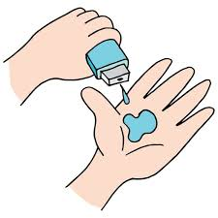
Land-registry using blockchain -
[Ashish Kumar]
ashishkumar7645092418@gmail.com
AICTE ID-STU66d09fa6c3cca1724948390
Under Guidance of
Aditya Dambale

Slide 2

PROBLEM STATEMENT
Land ownership records are often prone to fraud, disputes, and inefficiencies due to manual or centralized storage. A blockchain-based Land Registry System ensures secure, transparent, and tamper-proof land registration and ownership transfers. This smart contract automates verification, prevents forgery, and allows only rightful owners to transfer land.

Slide 3
Project Description
The Land Registry System is a blockchain-powered smart contract that enables secure, transparent, and tamper-proof land ownership management. It allows users to register land parcels, verify ownership, and transfer property rights securely without intermediaries.
Built on Ethereum (Solidity), this smart contract: Registers land with a unique ID, location, area, and owner details. Prevents fraud by ensuring only unregistered land can be added. Ensures secure ownership transfer—only the current owner can sell or transfer land. Provides instant verification—anyone can check land details via the blockchain.

Slide 4

WHO ARE THE END USERS?
Government Authorities
Landowners & Property Buyers
Financial Institutions & Banks
Real Estate Agents
Banks and Financial Institutions
Legal Professionals
Environmental and Urban Planning Agencies
Investors and Property Management Firms
Surveyors and Appraisers

Slide 5

Technology Used
Remix ide
solidity

Slide 6
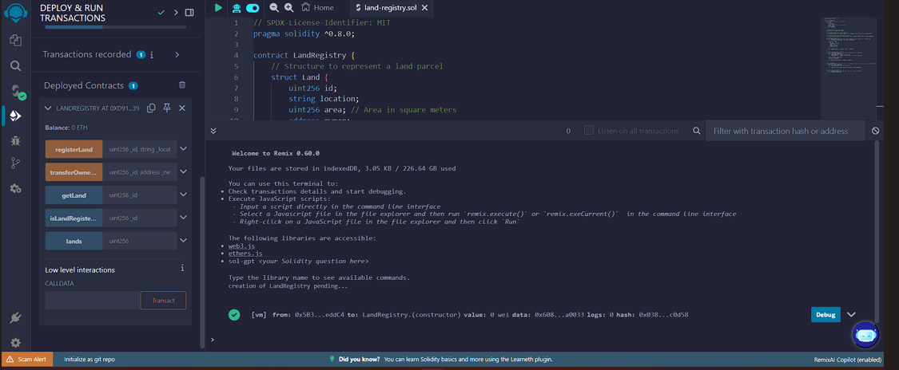
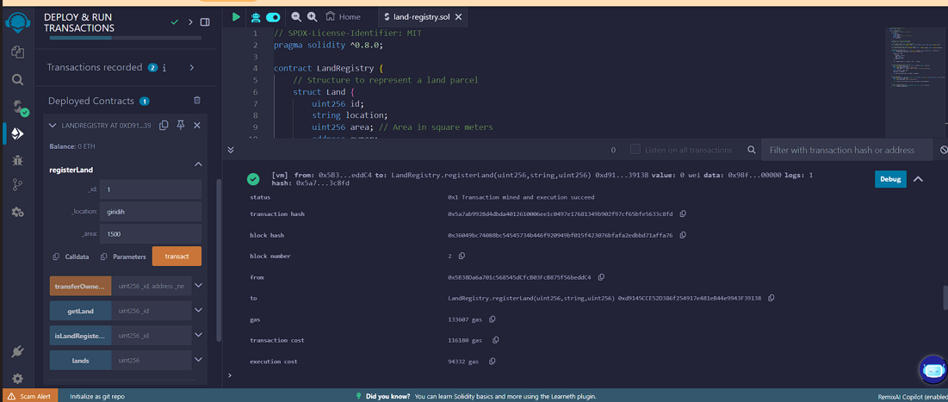
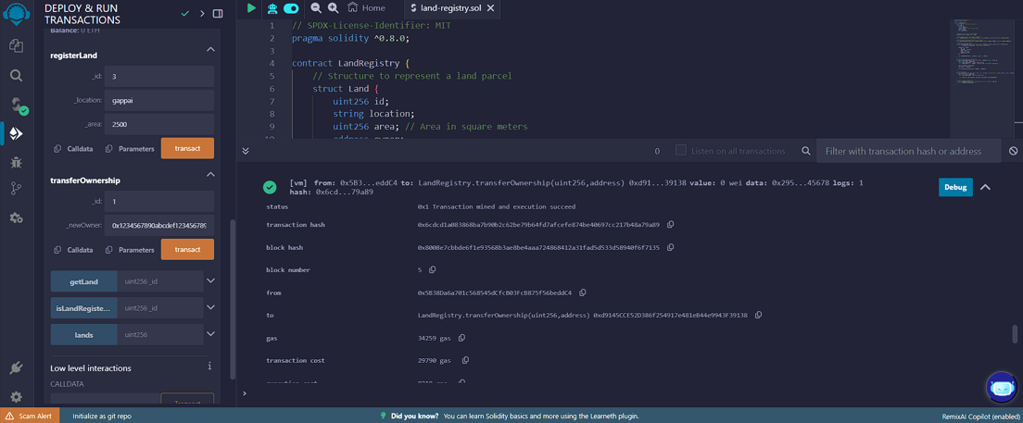
RESULTS
[1st screenshot]
[2nd screenshot]
[3nd screenshot]
Demo Link: https://github.com/ashish7645/Land-registry-using-blockchain-.git

Slide 7
Thank you
That's incredible. Having a mentor like Mr. Adaity Dambale can truly transform a project's trajectory. Leveraging blockchain for land registry isn't just innovative—it's a bold step toward enhancing transparency and trust in property transactions. It's fascinating how this technology, originally devised for cryptocurrencies, is now reshaping fundamental societal systems.
Platforms like VOIS are game-changers, too. They don't just teach skills; they empower students to push boundaries and create solutions that can have real-world impact. I'm curious—how did working on this project deepen your understanding of blockchain's potential in social applications? And in what ways did mentorship and supportive platforms influence your approach and outcomes?
.
.

